Slide 1
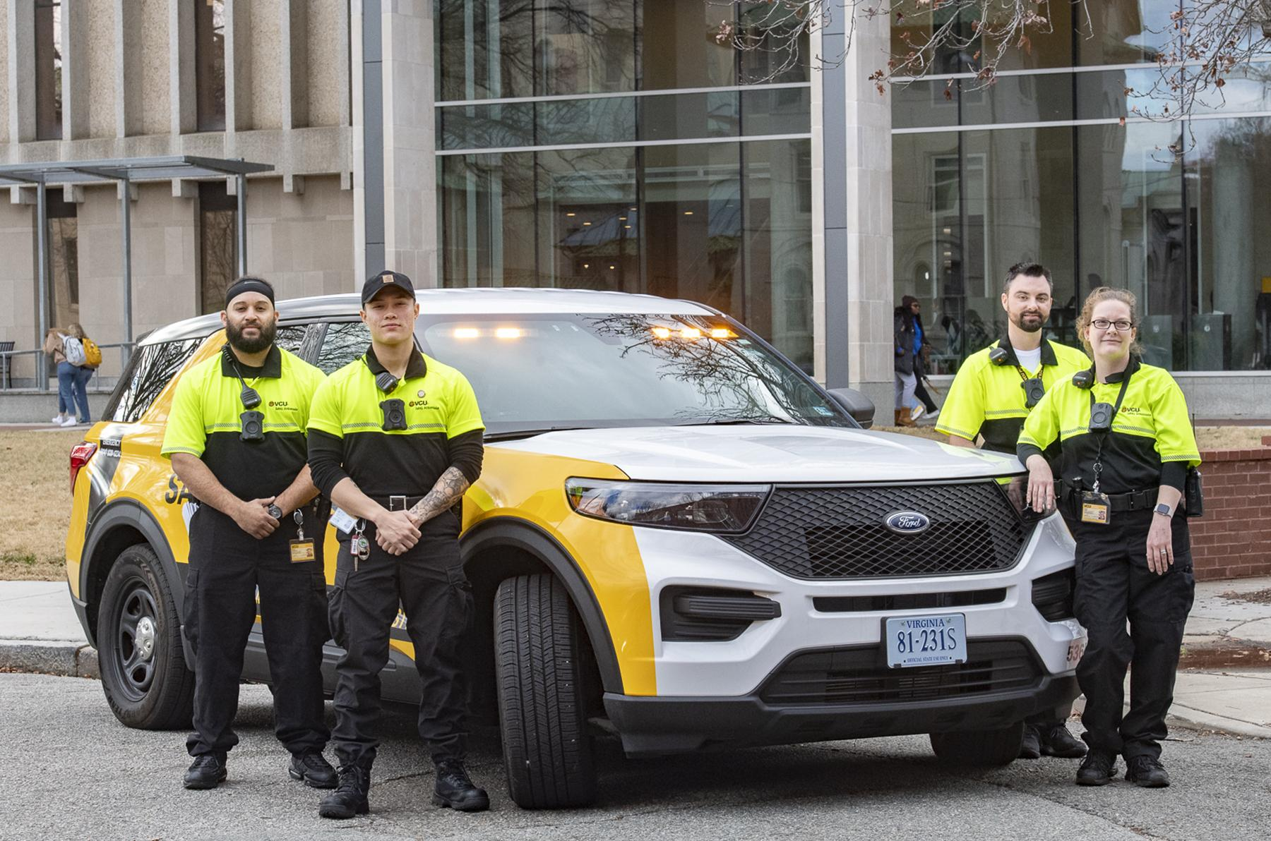

Alternative Response Approaches for Campus Safety

Slide 2
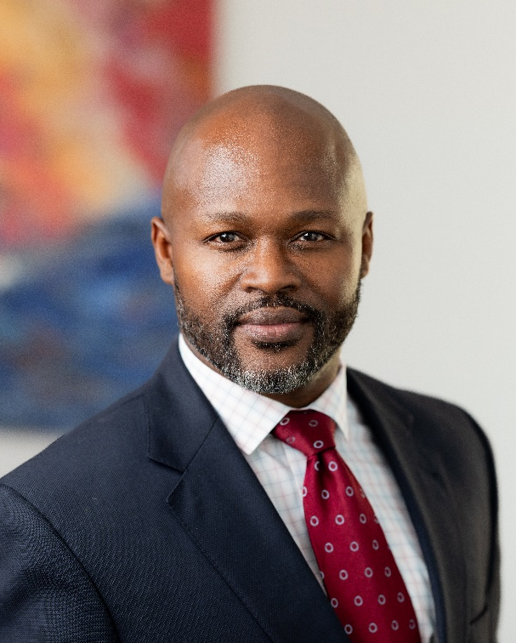
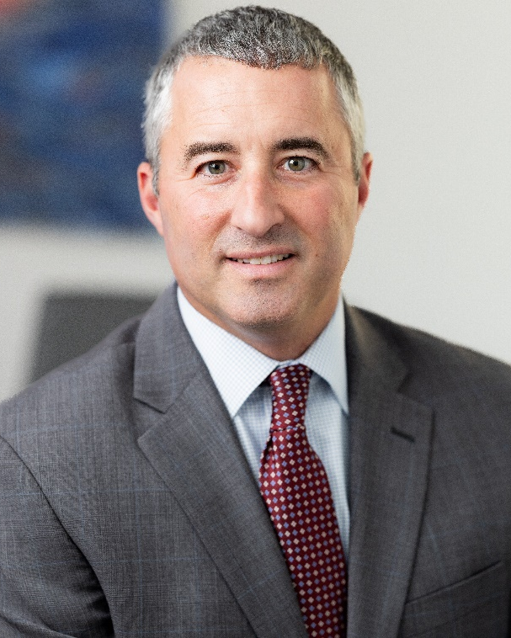
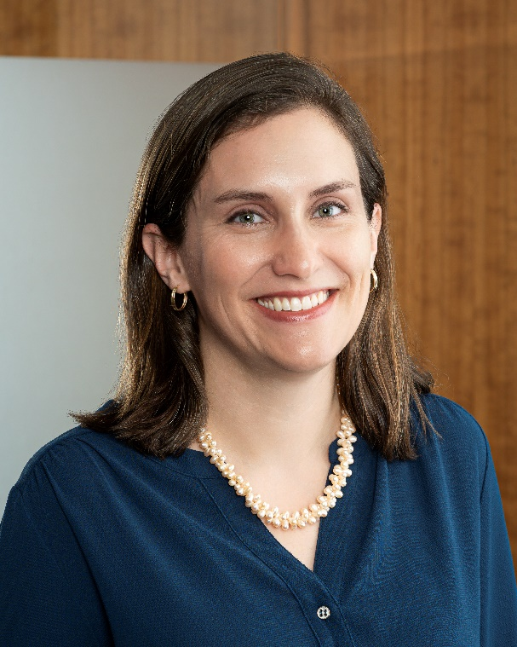
Speakers
  Dr. Diedrick Graham
  Vice President of Culture & Strategy, Healy +
  Michael J. Rein
  Director for Organizational Assessment Services, Healy +
Christine F. McHugh
Moderator
United Educators

Slide 3
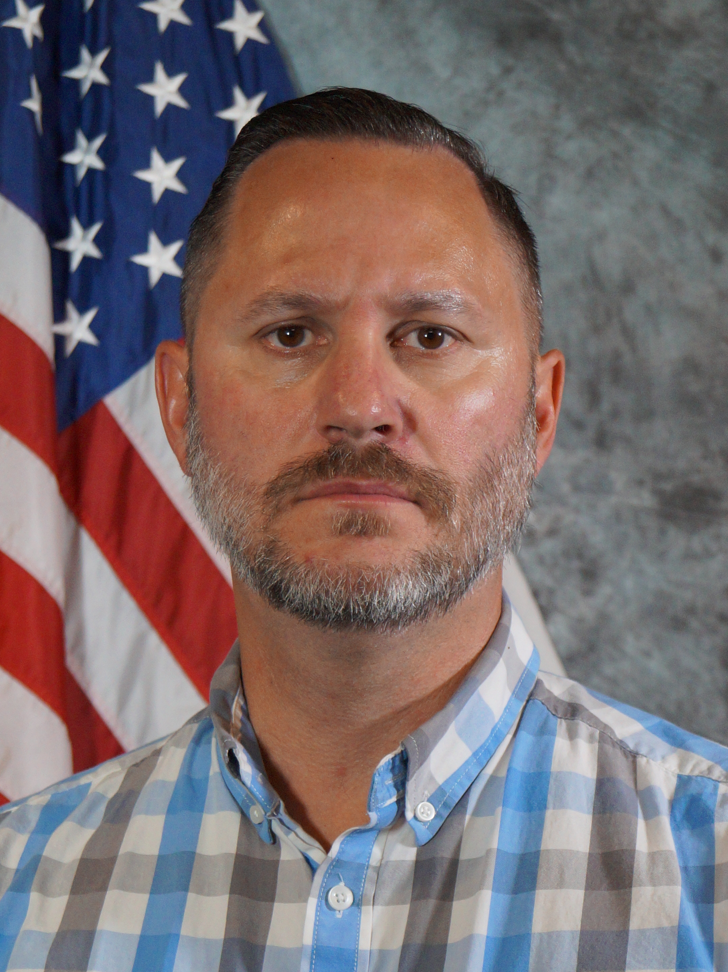
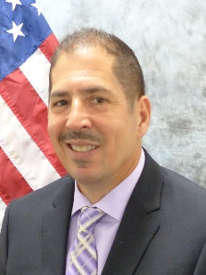
Virginia Commonwealth University Speakers
John Venuti
Associate Vice President for Public Safety, VCU & VCU Health and
Chief of Police
  Brian Sussman
  VCU Safety Ambassador Supervisor

Slide 4
Agenda
Setting the Stage
Campus perceptions of campus safety
Overview of Co-Responder models
Virginia Commonwealth University’s Safety Ambassador Program
Q&A Session

Slide 5
Setting the Stage
Healy +

Slide 6
Campus Perceptions of Campus Safety:
Introduction to Our Inquiry
Summary of our methods: Open forums, small group listening sessions & limited surveys
Why Now? – To be “student ready,” we must understand student perceptions and expectation re: campus safety.

Slide 7
Since 2020 we have conducted:
Hundreds of Listening/Community Engagement sessions at ~20 colleges and universities
Over 2000 students (forums, small groups, surveys, Zoom, etc.)
Amplified Voices of Racial, Cultural, and Social Identities (BIPOC, LGBTQAI+, Latino, Jewish, Students w/Disabilities, and other affinity groups)
During the listening sessions, more than 82% of students stated that they felt concerned about their safety
Notes:
The list of 10 universities that were discussed included:
- Arizona
- UCSD
- CSU (Colorado State University)
- Rochester
- Idaho
- Denver
- Colby
- St. John Fisher
- Portland State
- Columbia
_ Skidmore
- Illinois State

Slide 8
Common Recurring Themes
Theme 1: Communication & Transparency – Consensus around a lack of communication and transparency in the process and sense of exclusion
Theme 2: Relationship Building – Need to foster connection & repair harm
Theme 3: Education and Training – Lack of understanding of roles and experiences
Theme 4: Differential Response – By campus & nature of call
Theme 5: The “University Bubble” – Sense of exceptionalism/lack of understanding
Theme 6: Approach and Appearance of Campus Safety Officers – How they are in space is as important as what they do

Slide 9
Integrating Campus Safety Officers Insights
Acknowledge past tensions between campus police (& other police) and students, emphasizing a forward-looking approach.
Discuss "Practical Empathy" and how small changes can significantly impact student-police relations.
Explore ways to extend Campus Safety engagement beyond enforcement, fostering a community-oriented/guardian/servant culture.

Slide 10
General Recommendations
Communication, Transparency & Relationship Building
Open Forums & Improved Information Sharing: Continuous dialogue and effective communication of safety updates.
Engagement & Collaboration: Non-enforcement engagement programs and strengthened partnerships with entire campus.
Education, Training & Response Strategies
Cultural Competence and Community Education: Mandatory ongoing CS training and workshops for the campus community.
Differential Response, Crisis Co-Response: Right Fit; Mental health professionals for crises; reliable Safe Ride services.

Slide 11
General Recommendations (cont.)
Approach, Appearance & Cultural Shift
Reimagining CS & Visibility: Shift perception towards a supportive role with a non-militaristic appearance.
Adaptive Leadership & Anti-Oppression Training: Embrace adaptive leadership and mandatory anti-oppression training.
Addressing Sexual Assault & Enhancing Safety Culture
Sexual Assault Reporting: Victim-centered processes and gender-sensitive options.
Sustained Dialogue & Mindset Shift: Encourage meaningful dialogue and understanding of diverse student needs.
Commitment to Inclusive Safety
Unified Effort: Leadership and campus safety commitment to sustained change through listening
Goal: A campus safety model that champions safety, inclusion, and respect.

Slide 12
Evolution of Co-Responder Models
Leveraging the right resource to address public/campus safety needs.
Some approaches include taking police officers out of situations that do not require them.
Providing de-escalation training to police.
“Co-Response” means different things in different places.
First teams, established in the 1970’s and 1980’s, paired police officers with mental health professionals to respond to crisis calls.
Co-responder programs have a 50-year history, but many programs were launched in the last 5-10 years.
CIT
De-Escalation
Co-Responder
Differential Response

Slide 13
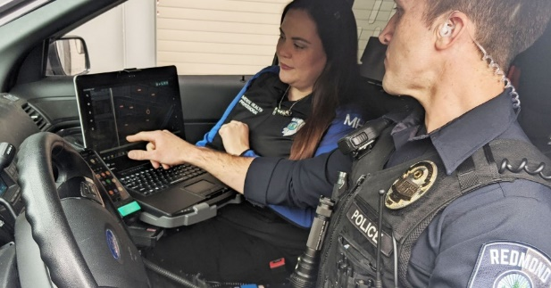
Co-Responder Models
Trained campus safety officers and a mental health professional who respond to behavioral emergencies as a team
Interdisciplinary team
Specialized training via team approach
Cooperative response
Assessment, triage, follow-up, & referral

Slide 14
Co-Responder Models
Cops, Clinicians, or Both? Collaborative Approaches to Responding to Behavioral Health Emergencies
Notes:
Cops, Clinicians, or Both? Collaborative Approaches to Responding to Behavioral Health Emergencies
https://www.nasmhpd.org/sites/default/files/2020paper11.pdf

Slide 15
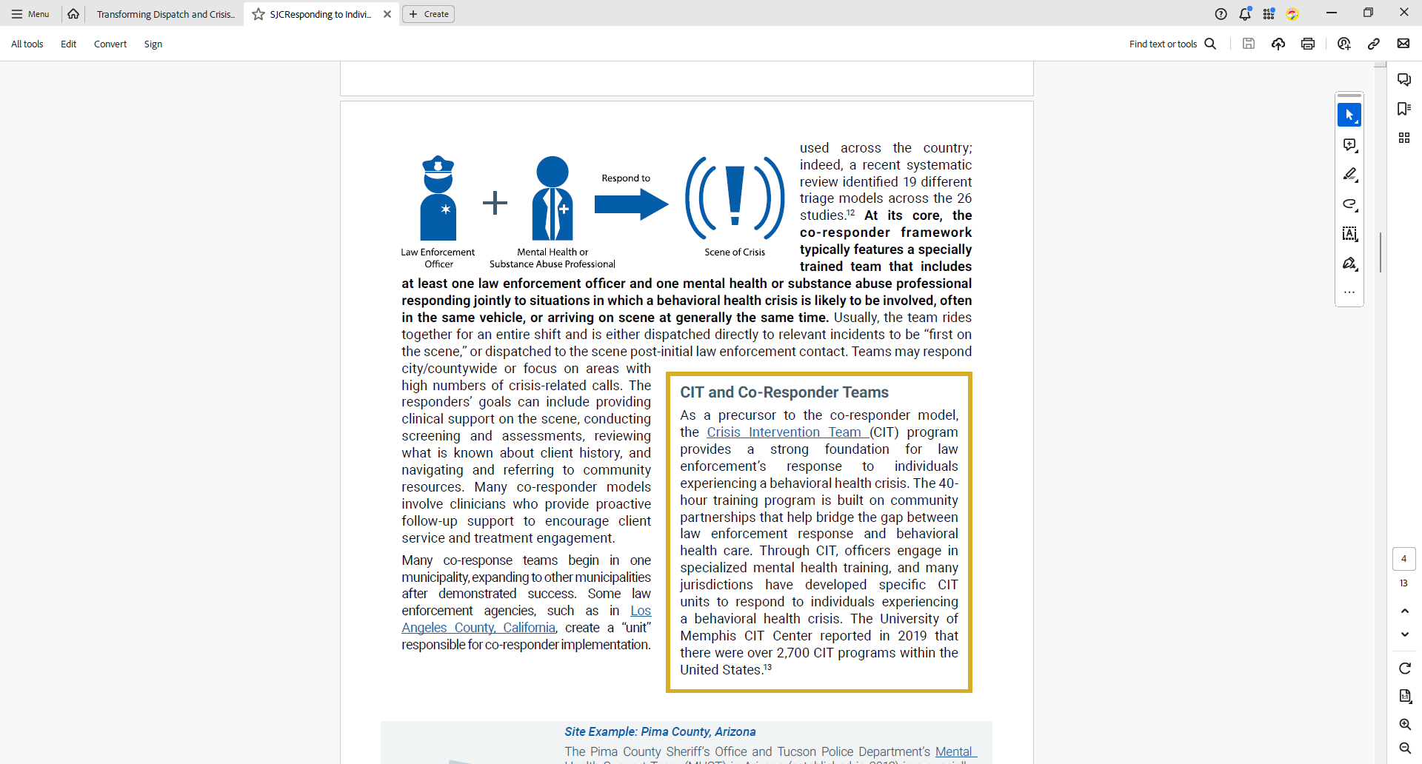
Co-Responder Models
Alternative Response (City of Cambridge –Community Assistance Response and Engagement Team); (City of Eugene – CAHOOTS – Crisis Assistance Helping Out on the Streets); and (Virginia Commonwealth University – CVU Safety Ambassadors)
Police Call for After-Event Support
Police Obtain Clinical Support Virtually
FD & EMS Partner with Clinicians (SF Street Crisis Response Team)
Multi-Professional Teams (Johns Hopkins University – Behavioral Health Crisis Support Team)
Police Call for Non-Clinical Support
Peer Support Workers Join w/Police
Clinical Staff Advise within the
Dispatch Center
Notes:
Law Enforcement Calls for After-Event Support
In some co-responder models, responding officers will refer to a behavioral health specialist after encountering someone in need of assistance
Site Example: Kitsap County, Washington
Law Enforcement Obtains Clinical Support Virtually
Virtual crisis support such as telehealth enables the remote delivery of services, overcoming the rural, geographic, and transportation challenges experienced in many models of delivery of care. Officers may request that counselors evaluate individuals experiencing a crisis to help determine the most appropriate course of action. This can include the use of a crisis line to direct the response or video conferencing.
Site Example: Springfield, Missouri
Fire Department and/or Emergency Medical Services Join Law Enforcement and Clinicians
Emergency Medical Services (EMS) and fire departments are increasingly involved in specialized crisis response, such as through trained EMS teams that respond to crisis calls with law enforcement. In addition, some fire/medical co-responder teams may proactively reach out to people with mental illness who are frequently involved in calls for service to increase their stability in the community and connect to relevant services.
Site Example: Colorado Springs, Colorado
Multi-Professional Teams, Especially for Substance Abuse Intervention
Some co-responder teams are targeted to intervene around specific issues, such as human trafficking, homelessness, and often substance abuse. These targeted interventions may include both proactive outreach and opioid overdose follow-up.
Site Example: Plymouth County, Massachusetts
Law Enforcement Calls for Non-Clinical Support
Law enforcement can request dispatch of trained civilians, instead of clinicians. These trained civilians may include trained behavioral health volunteers, crisis workers, or other non-clinical professionals. The team may also serve the community on its own as a mobile crisis response.
Site Example: Albuquerque, New Mexico
Peer Support Workers Join Law Enforcement
Peers (peer support staff, peer support specialists, or peer recovery coaches) are individuals with lived experiences of mental illness, substance use disorders, and/or justice involvement who are trained or certified to provide supportive services. Peer support is particularly helpful in easing the potential trauma of the justice system process and encouraging consumers to engage in treatment services.
Site Example: Mental Health Association of Nebraska
Clinical Staff Advise from Dispatch Centers
Some jurisdictions have integrated behavioral health counselors or other clinicians directly within their 9-1-1/dispatch call centers to provide even earlier crisis resolution and diversion. In other areas, such as Broome County, New York, there can be a warm handoff of some calls from 9-1-1 dispatchers to crisis call lines, to address non-emergent behavioral health treatment needs.
Site Example: Harris County, Texas
Behavioral Health Navigators Join Law Enforcement at Point of Reentry
There is a growing understanding among jurisdictions across the country about the importance of ensuring successful reentry for people with serious mental illness and chronic behavioral health needs. These individuals are often caught in a cycle of hospitalization, homelessness, and jail. Clinicians and peers in this model are part of the larger co-response team but assigned to the local jail or prison to aid in community reentry.
Site Example: Denver, Colorado
https://www.theiacp.org/sites/default/files/SJCResponding%20to%20Individuals.pdf

Slide 16
Safety Ambassador Program
Virginia Commonwealth University

Slide 17

Virginia Commonwealth University
Virginia Commonwealth University in Richmond, Virginia is among the nation’s premier urban, public research universities.
VCU enrolls more than 28,000 students in more than 200 degree and certificate programs.
VCU encompasses one of the largest academic health
centers in the nation, VCU Health, where the VCU
Medical Center was named the No. 1 hospital in the
Richmond region by U.S. News & World Report.
The 127.5-acre Monroe Park Campus is located in
Richmond’s Fan District, and the 70.5-acre MCV
Campus is adjacent to the State Capitol. VCU
occupies 274 buildings with a residence hall capacity
of nearly 6,000 students.

Slide 18
Safety and Well-being Advisory Committee
Virginia Commonwealth University's responsibility to embrace diversity and create an equitable environment where everyone can thrive, regardless of cultural background, life experience or identity, has led to its continued work to address the very real inequities affecting our communities. Of particular concern is law enforcement's interactions with ethnic, racial, gender and sexual minorities, particularly those involving African American communities.
The Safety and Well-being Advisory Committee (SWAC) was established to develop recommendations to advance VCU's public safety model, fostering systemic and tactical reforms that support the safety and well-being of every individual on campus. SWAC was charged with defining the components of a new transformational model for public safety, leveraging a transdisciplinary approach to better meet the VCU community's needs.
Per the recommendation of the SWAC the Safety Ambassador Program was developed, which is an alternative police response program, comprised of civilian employees.

Slide 19

Safety Ambassadors
Student Safety Ambassadors
19

Slide 20
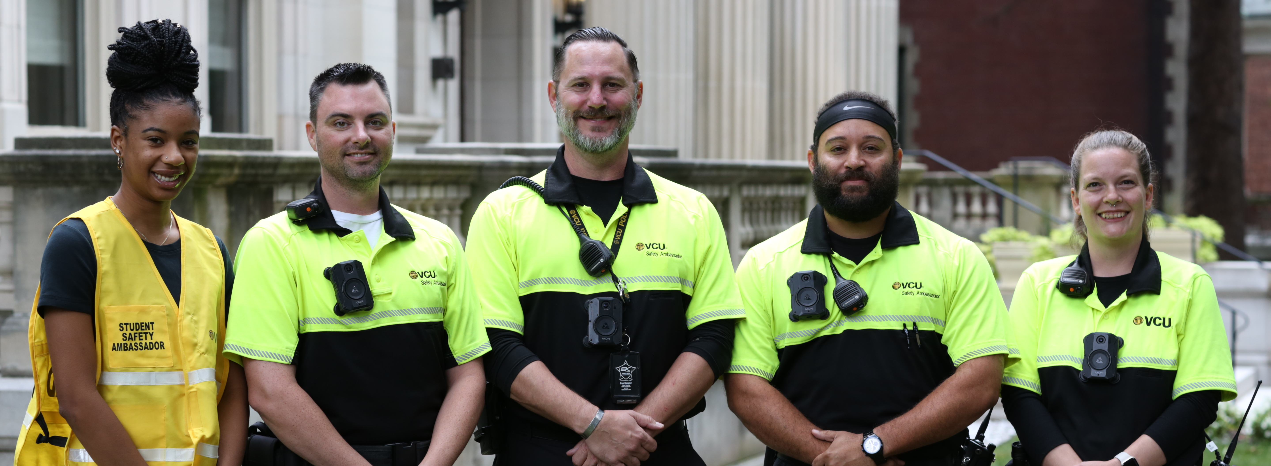
Hiring the Right People as Safety Ambassadors

Slide 21
Training
Radio Training – All member of the unit will learn 10 Codes and how to speak over the radio correctly when clearing and responding to calls. Assign the team permanent call numbers. IE 400 unit’s
Property – Make sure applicants are familiar with your specific environment. Learning the property will be built into the ride-a-long training.
Body Worn Cameras (BWC) – These cameras will be worn when responding to calls and interactions with the public. Very important that BWC’s are built into the policy and procedures.
Crisis Intervention Training (CIT) – It is important for this unit to be highly trained in this area. Having this training should have them ready to respond to calls that will invoke the training.
De-escalation/Mental Health Training – This will be required of all officers. This training combined with CIT will allow the officer to be confident in handling any adverse situation in your environment.
Directing Traffic – Officers will be trained on how to properly direct traffic for emergency and special events

Slide 22
Training
CPR/AED Training – This training could be potentially life saving. This will be required of all officers to participate in and pass the course.
First Aid – All officers will be assigned a first aid kit that they can wear on their person. Each pouch will have the basic first aid components incase of emergency.
Recovered Property – Co response units should be able to properly log in property to evidence. Any found weapons/narcotics should be handled by sworn officers.
Other Needed Training – Fair and Impartial Policing, Cultural Diversity, Community Policing/Crime Prevention, Vehicle Maintence and inspections.
You can create a training program that is unique to your department.

Slide 23
Team Effectiveness
De Escalation – Our team can deescalate a situation by our appearance alone. SA’s do not wear vests, carry weapons, OC. This helps to de escalate potential volatile situations.
Engagement – Because we are not armed it shuts down a potential barrier with the student body and allows an immediate trust and understanding with ever encounter.
Effectiveness – We as a team can engage the student body which allows us to be more effective when responding to the needs of the community

Slide 24
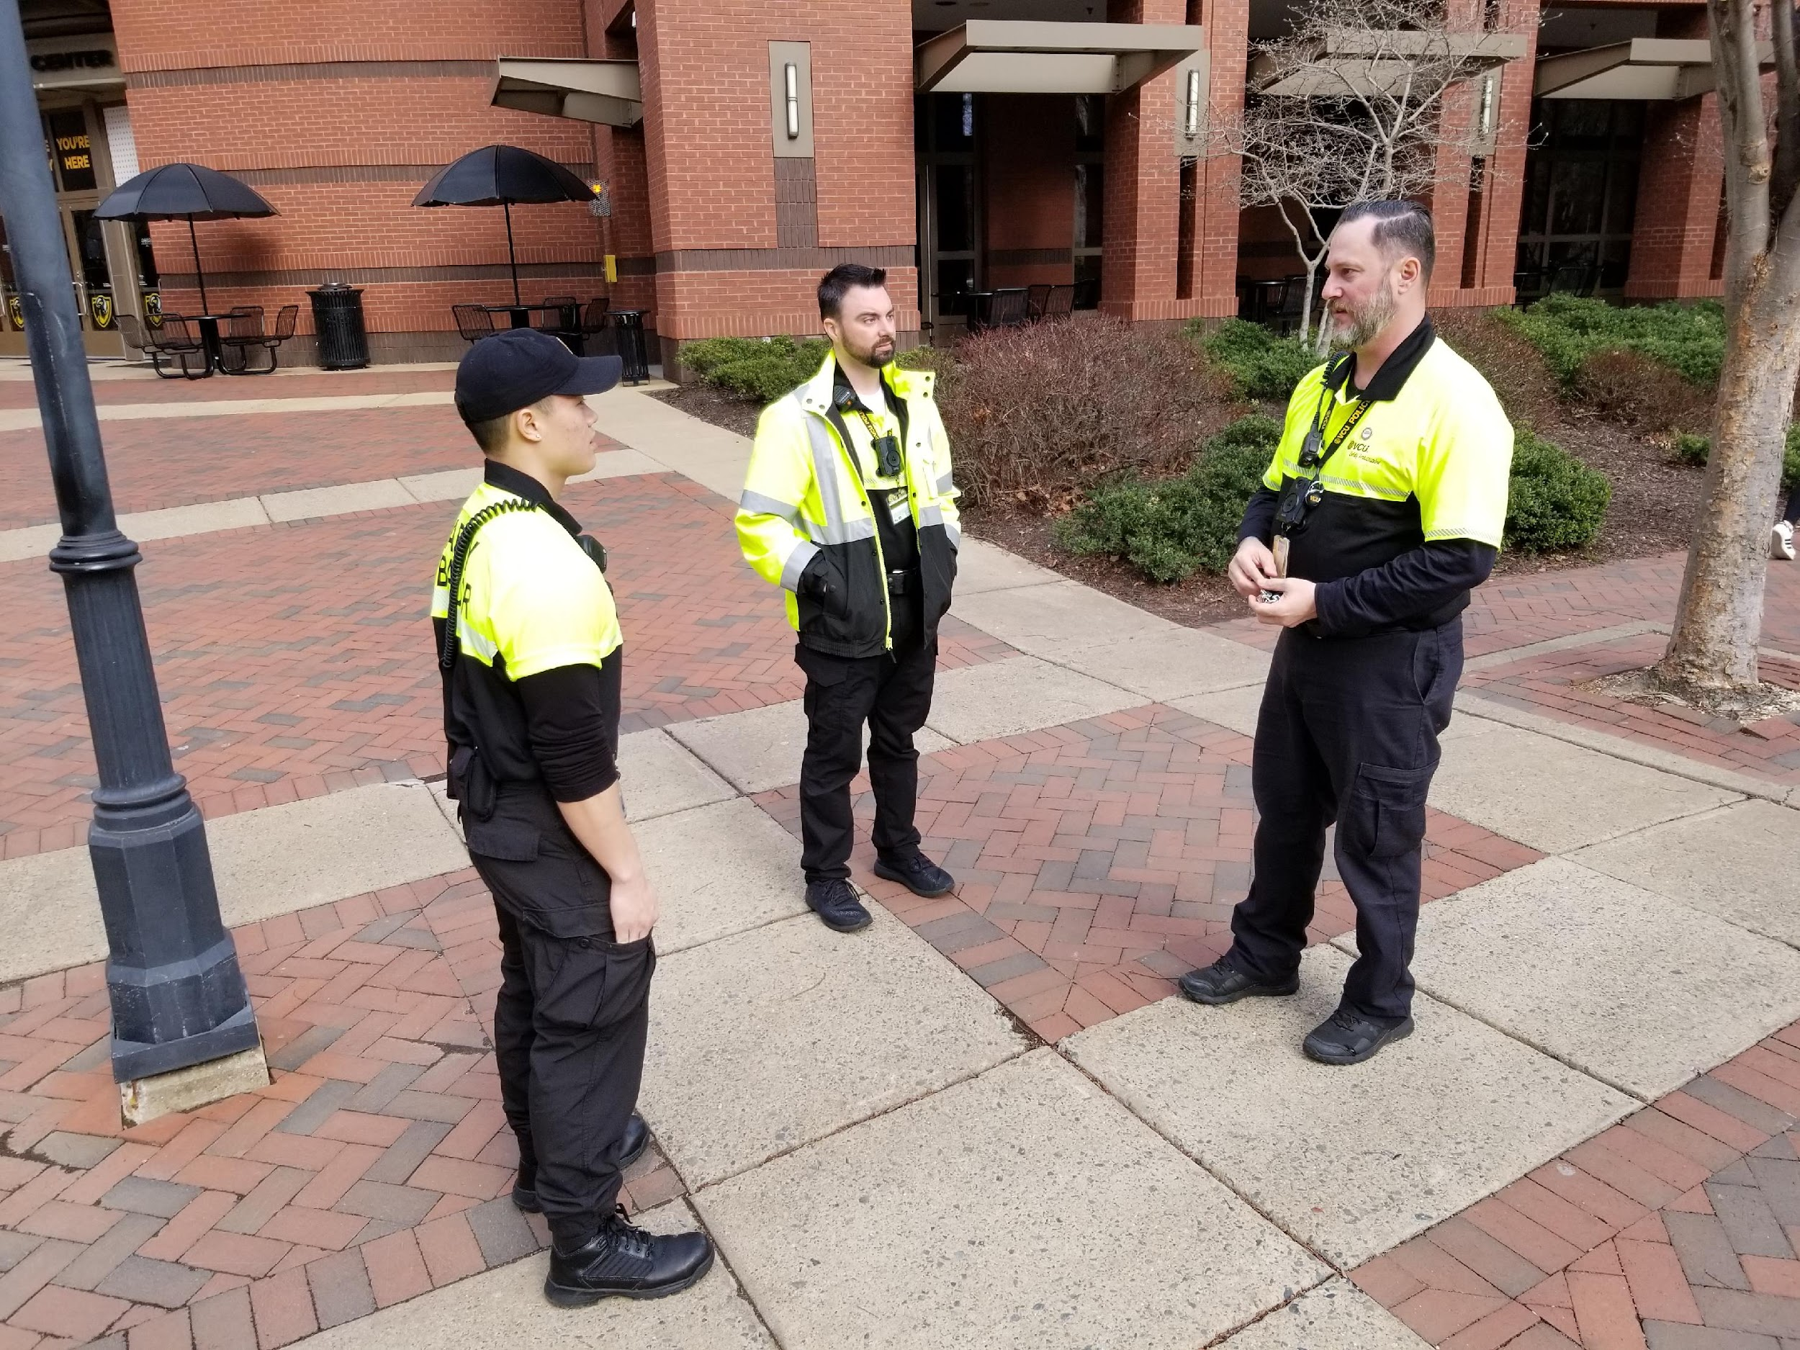
Similarities to Police Officers
Ambassadors are held to the same standard in reporting crime as police officers.
The uniform is similar to police officers and it was chosen to allow the ambassador to be easily identifiable to students, faculty and staff.
Ambassadors are equipped with a radio to be in constant contact with the Emergency Communications Center (VCU Police dispatch).

Slide 25
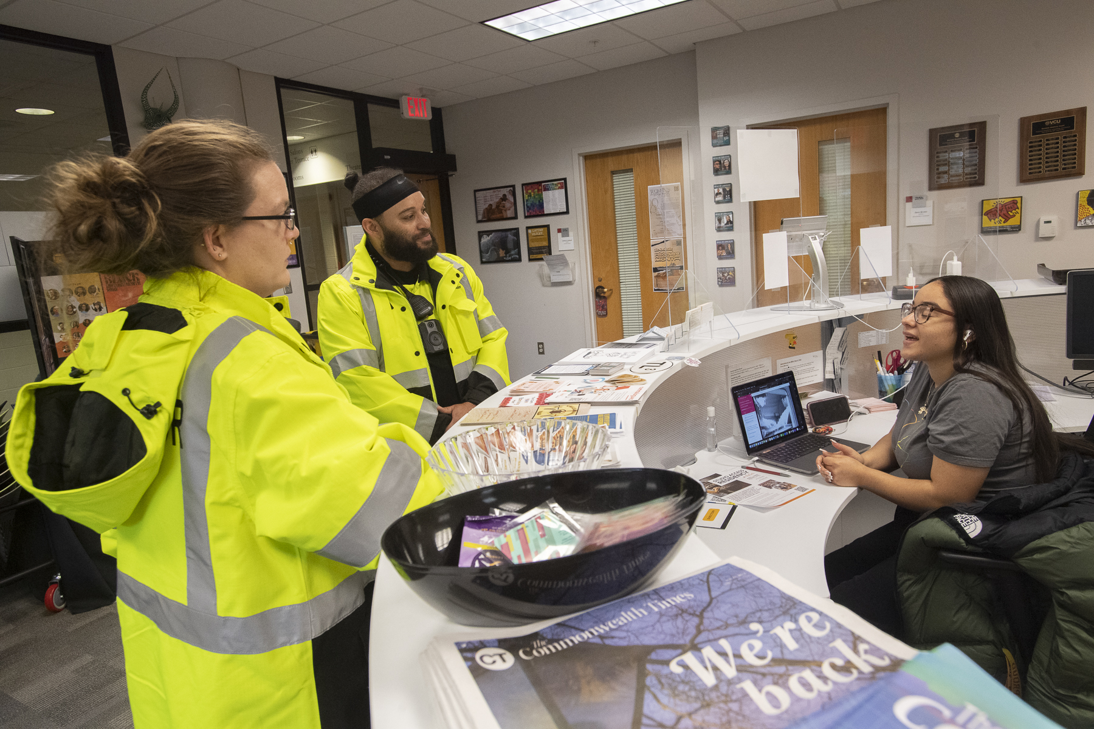
Differences from Police
No fear of arrest or detention as the Safety Ambassador have no arrest authority.
Students are more apt to look to the Safety Ambassadors for help.
Students will report concerning incidents to the team or over the LiveSafe application.
Notes:
Will Wright Example….

Slide 26
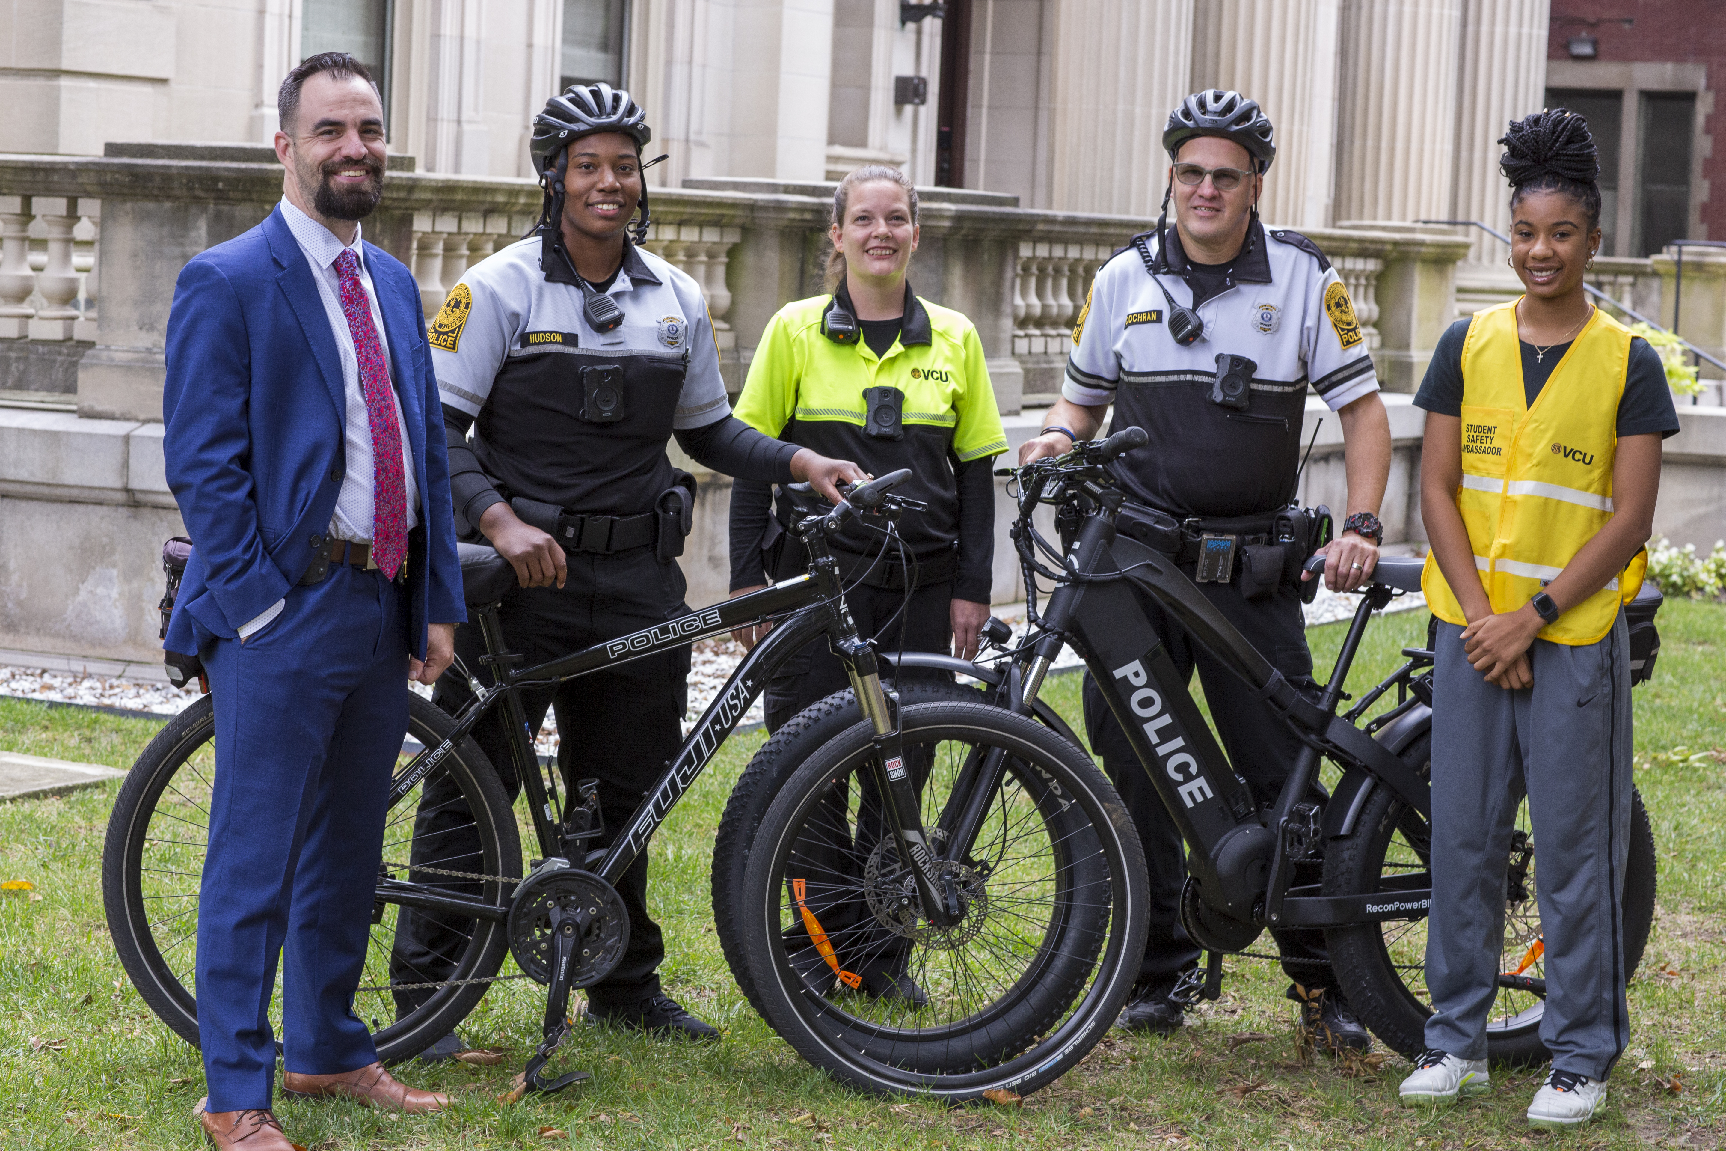
Total Calls for Service
Implemented 1/17/2023
As a department VCUPD’s ECC handled 110,901 calls for service in 2023. This includes all initiated calls.
The Safety Ambassador team (4 civilians) accounted for 5,839 calls.
5,839 is roughly 6% of ALL calls that came into the ECC.

Slide 27
VTCC Transports
VTCC transports - Transporting children to the Virginia Treatment Center for Children
As of March 22, 2023, VCUPD handled 74% of all VTCC calls for service. SA’s handled 26%. Total Calls= 107
As of March 22, 2024, SA’s have handled 70% of all VTCC Calls total so far 81.
This is just one call for service that the team has made a huge impact

Slide 28
Questions?

Slide 29





